Slide 1

COMS W4111 - Introduction to Databases
NoSQL Databases
Donald F. Ferguson (dff@cs.columbia.edu)
Lecture 12: No SQL

Slide 2

Transactions and REST
2 | Introduction to Databases (S20): Lecture 12 -- NoSQL

Slide 3
REST
"Representational State Transfer (REST) is an architectural style that defines a set of constraints to be used for creating web services. Web Services that conform to the REST architectural style, or RESTful web services, provide interoperability between computer systems on the Internet. REST-compliant web services allow the requesting systems to access and manipulate textual representations of web resources by using a uniform and predefined set of stateless operations. Other kinds of web services, such as SOAP web services, expose their own arbitrary sets of operations." (Emphasis added).(https://en.wikipedia.org/wiki/Representational_state_transfer)
The six core characteristics of the REST style are:Client–server architecture
Statelessness
Cacheability
Layered system
Code on demand (optional)
Uniform interface

Slide 4
State
REST Statelessness is easy to misunderstand.
The server clearly has long-lived state information, e.g.
Account balances.
Customer contact information.
Product catalog information in a database.
etc.
Client-Server interactions have two types of state:
Resource state
Conversation/Session
"In computer science, in particular networking, a session is a temporary and interactive information interchange between two or more communicating devices, or between a computer and user." (https://en.wikipedia.org/wiki/Session_(computer_science))

Slide 5
State
REST Statelessness is easy to misunderstand.
The server clearly has long-lived state information, e.g.
Account balances.
Customer contact information.
Product catalog information in a database.
etc.
Client-Server interactions have two types of state:
Resource state
Conversation/Session
"In computer science, in particular networking, a session is a temporary and interactive information interchange between two or more communicating devices, or between a computer and user." (https://en.wikipedia.org/wiki/Session_(computer_science))
Connections, sessions and cursors are “conversation statefull” and conflict with REST, which makes transactions difficult.
REST applications use a form of optimistic concurrency control, explicit conflict detection and application level recovery.
We saw a similar problem with LIMIT and OFFSET in HW 2

Slide 6
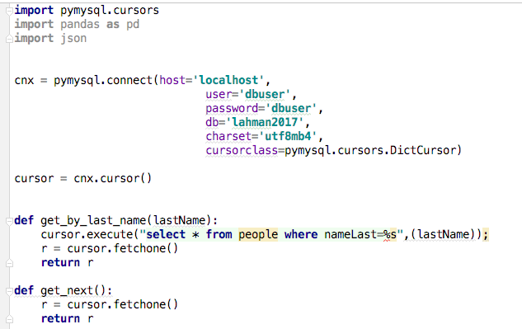
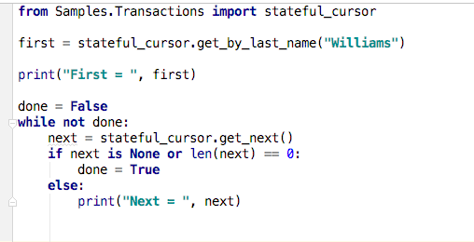
Client – Server State and Cursors Concept
(Logical) Server
(Logical) Client
Stateful session.

Slide 7
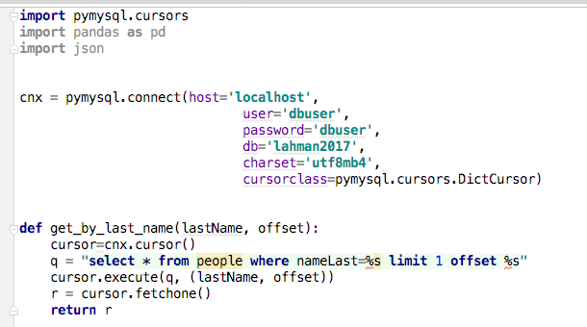
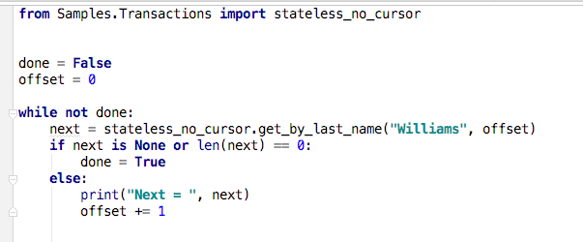
Client – Server State and Cursors Concept
(Logical) Server
(Logical) Client
Stateless interaction

Slide 8
Read then Update Conflict
Some
Resource
1. Bob GETs the resource.
3. Bob changes the data based on values.
2. Mary GETs the resource.
If
The written value
Depends on the read value.
The resource may be in the wrong state at the end.
The execution was RRWW
But the intent was RWRW.
4. Mary changes the data based on values.

Slide 9
Isolation/Concurrency Control
There are two basic approaches to implementing isolation
Locking/Pessimistic, e.g. cursor isolation
Optimistic: Before committing, each transaction verifies that no other transaction has modified the data it has read.
How does this work in REST?
The server maintains an ETag (Entity Tag) for each resource.
Every time a resource’s state changes, the server computes a new ETag.
The server includes the ETag in the header when returning data to the client.
The server may optionally maintain and return “Last Modified” time for resources.
Semantics on updates
If-Match – value of a previous calls ETag response used with a PUT or DELETE. Server should only act if nobody else has modified the resource since you last fetched it. Otherwise provides a 412.
If-Modified-Since – value of a previous Last-Modified response used with a GET. Server should only provide a response if the resource was modified since the timestamp submitted. Use in conjunction with If-None-Match in case the change occurred within the same second. Otherwise provide a 304.
If-None-Match – value of a previous calls ETag response used with a GET. Server should only provide a response if the ETag doesn’t match, i.e. the resource has been altered. Otherwise provide a 304.
If-Unmodified-Since – value of a previous Last-Modified response used with a PUT or DELETE. Server should only act if nobody else has modified the resource since you last fetched it. Otherwise provides a 412

Slide 10
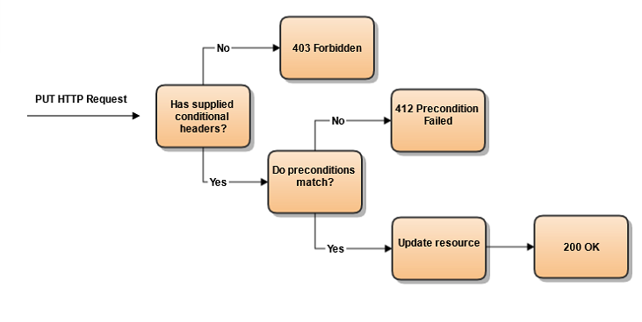
Conditional Processing (https://blog.4psa.com/rest-best-practices-managing-concurrent-updates/)

Slide 11
ETag Processing

Slide 12

NoSQL Databases
12 | Introduction to Databases (S20): Lecture 12 -- NoSQL

Slide 13
Introduction
13 | Introduction to Databases (S20): Lecture 12 -- NoSQL

Slide 14
Overview (I) (https://en.wikipedia.org/wiki/NoSQL)
A NoSQL (originally referring to "non SQL" or "non relational")^{[1]} database provides a mechanism for storage and retrieval of data that is modeled in means other than the tabular relations used in relational databases. Such databases have existed since the late 1960s, but did not obtain the "NoSQL" moniker until a surge of popularity in the early twenty-first century,^{[2]} triggered by the needs of Web 2.0 companies such as Facebook, Google, and Amazon.com.^{[3][4][5]} NoSQL databases are increasingly used in big data and real-time web applications.^{[6]} NoSQL systems are also sometimes called "Not only SQL" to emphasize that they may support SQL-like query languages.^{[7][8]}
Motivations for this approach include: simplicity of design, simpler "horizontal" scaling to clusters of machines (which is a problem for relational databases),^{[2]} and finer control over availability. The data structures used by NoSQL databases (e.g. key-value, wide column, graph, or document) are different from those used by default in relational databases, making some operations faster in NoSQL. The particular suitability of a given NoSQL database depends on the problem it must solve. Sometimes the data structures used by NoSQL databases are also viewed as "more flexible" than relational database tables.^{[9]}
Notes:
Relaxes integrity of relational model: speeds up updates, creates scalability, performance
Relax transactional restraints

Slide 15
Overview (I) (https://en.wikipedia.org/wiki/NoSQL)
“Many NoSQL stores compromise consistency (in the sense of the CAP theorem) in favor of availability, partition tolerance, and speed. Barriers to the greater adoption of NoSQL stores include the use of low-level query languages (instead of SQL, for instance the lack of ability to perform ad-hoc joins across tables), lack of standardized interfaces, and huge previous investments in existing relational databases.^{[10]} Most NoSQL stores lack true ACID transactions, … …
Instead, most NoSQL databases offer a concept of "eventual consistency" in which database changes are propagated to all nodes "eventually" (typically within milliseconds) so queries for data might not return updated data immediately or might result in reading data that is not accurate, a problem known as stale reads.^{[11]} Additionally, some NoSQL systems may exhibit lost writes and other forms of data loss.^{[12]} Fortunately, some NoSQL systems provide concepts such as write-ahead logging to avoid data loss.^{[13]} For distributed transaction processing across multiple databases, data consistency is an even bigger challenge that is difficult for both NoSQL and relational databases. Even current relational databases "do not allow referential integrity constraints to span databases."^{[14]}

Slide 16
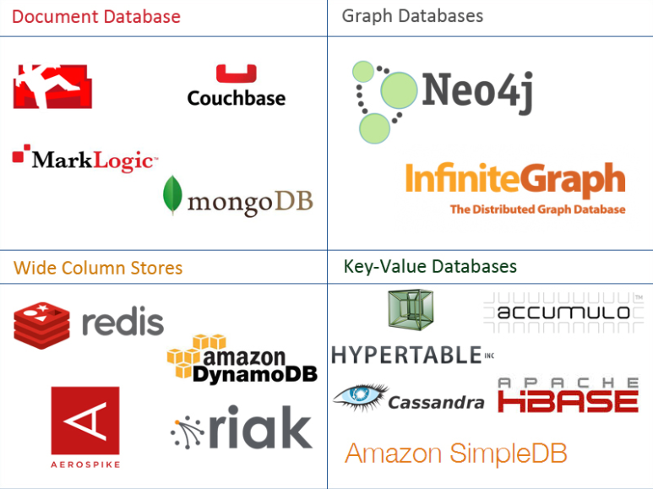
One Taxonomy
Notes:
Wide column: allows non-atomic domains
Key-value: self-explanatory – only stores key and its value, no other info about the data

Slide 17
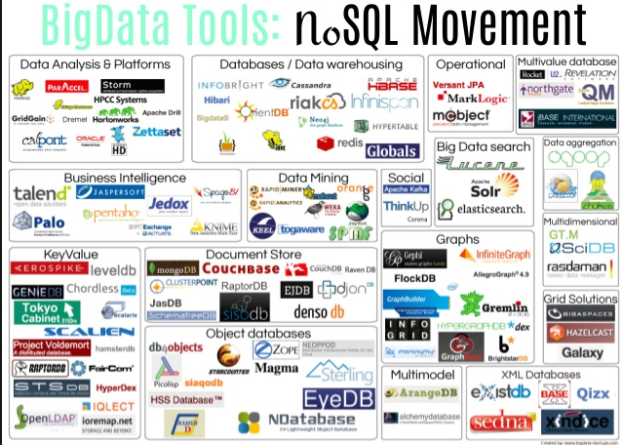
Another Taxonomy

Slide 18
CAP Theorem
18 | Introduction to Databases (S20): Lecture 12 -- NoSQL

Slide 19
ACID

Slide 20
CAP Theorem
Consistency
Every read receives the most recent write or an error.
Availability
Every request receives a (non-error) response – without guarantee that it contains the most recent write.
Partition Tolerance
The system continues to operate despite an arbitrary number of messages being dropped (or delayed) by the network between nodes
Notes:
Not really a theorem…
Also not necessarily true…
Partition tolerance: not all nodes in a network can communicate

Slide 21
Consistency Models
STRONG CONSISTENCY: Strong consistency is a consistency model where all subsequent accesses to a distributed system will always return the updated value after the update.
WEAK CONSISTENCY: It is a consistency model used in distributed computing where subsequent accesses might not always be returning the updated value. There might be inconsistent responses.
EVENTUAL CONSISTENCY: Eventual consistency is a special type of weak consistency method which informally guarantees that, if no new updates are made to a given data item, eventually all accesses to that item will return the last updated value.

Slide 22
Eventual Consistency
Availability and scalability via
Multiple, replicated data stores.
Read goes to “any” replica.
PUT/POST/DELETE
Goes to any replica
Change propagate asynchronously
GET may not see the latest value if the update has not propagated to the replica – not consistent
There are several algorithms for conflict resolution
Detect and handle in application.
Clock/change vectors/version numbers
… …
get
put
Notes:
What if WRITE is based on non-updated GET? Use timestamps/version numbers to abort transactions accordingly
Can also lock all copies - requires completely connected network of data stores… (Consistent and Available, but not Partition-tolerant)

Slide 23
Graph Databases
23 | Introduction to Databases (S20): Lecture 12 -- NoSQL

Slide 24
Graph Database
Exactly what it sounds like
Two core types
Node
Edge (link)
Nodes and Edges have
Label(s) = “Kind”
Properties (free form)
Query is of the form
p1(n)-p2(e)-p3(m)
n, m are nodes; e is an edge
p1, p2, p3 are predicates on labels
Notes:
Unlike relational model, where relationships can’t have properties, and rows can’t have multiple labels
Properties: not typed
Nothing like table definitions; any node can

Slide 25
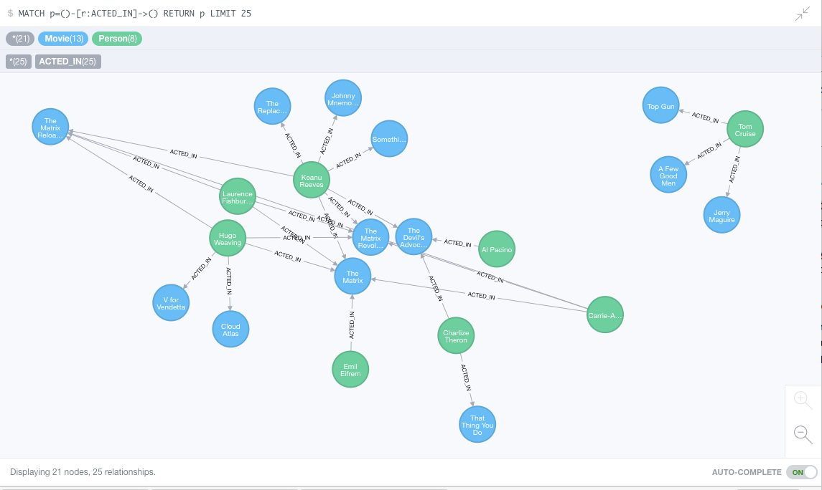
Neo4J Graph Query

Slide 26
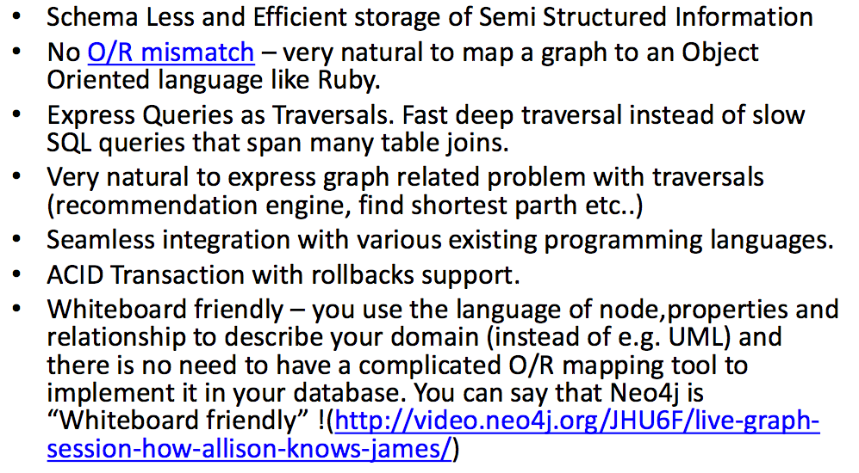
Why Graph Databases?

Slide 27
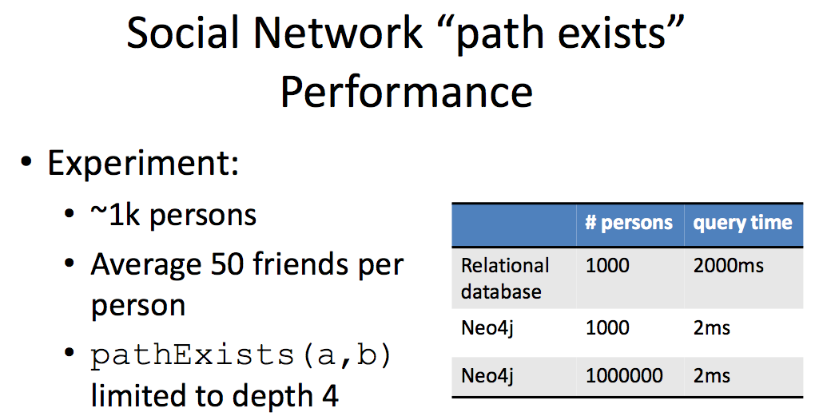
Graph databases are
Extremely fast for some queries and data models.
Implement a language that vastly simplifies writing queries.

Slide 28
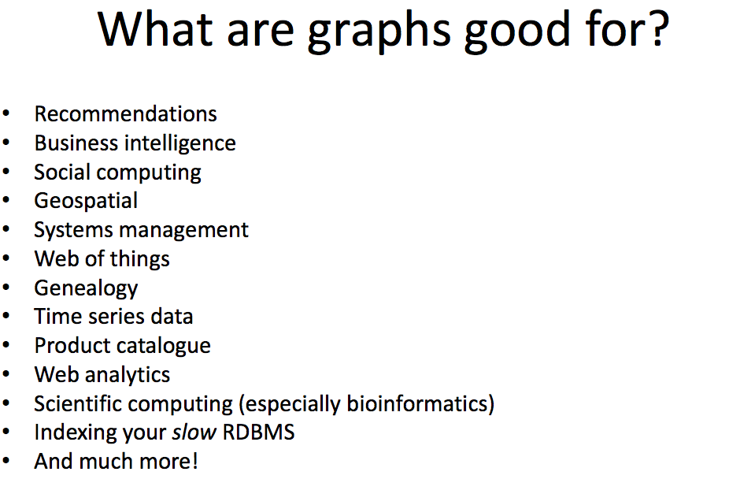

Slide 29
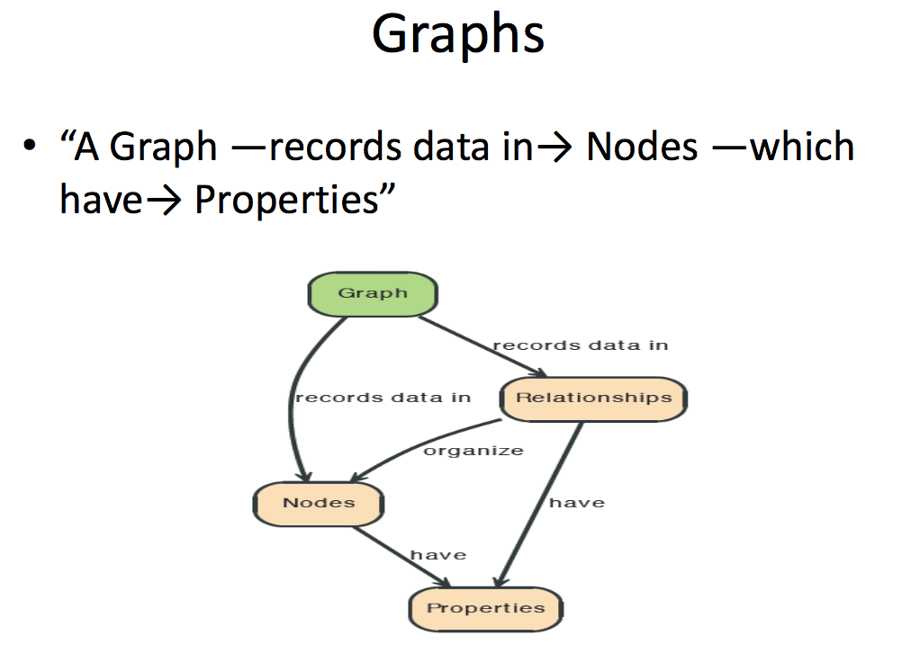

Slide 30
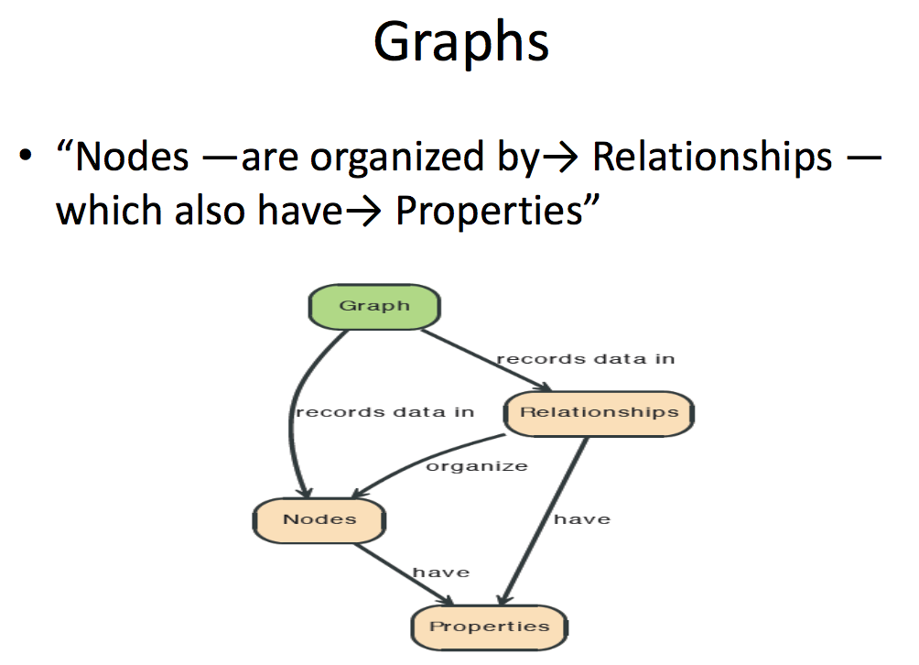

Slide 31
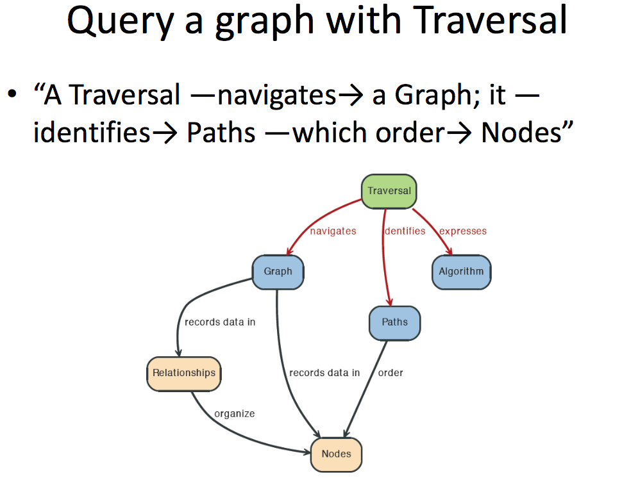

Slide 32
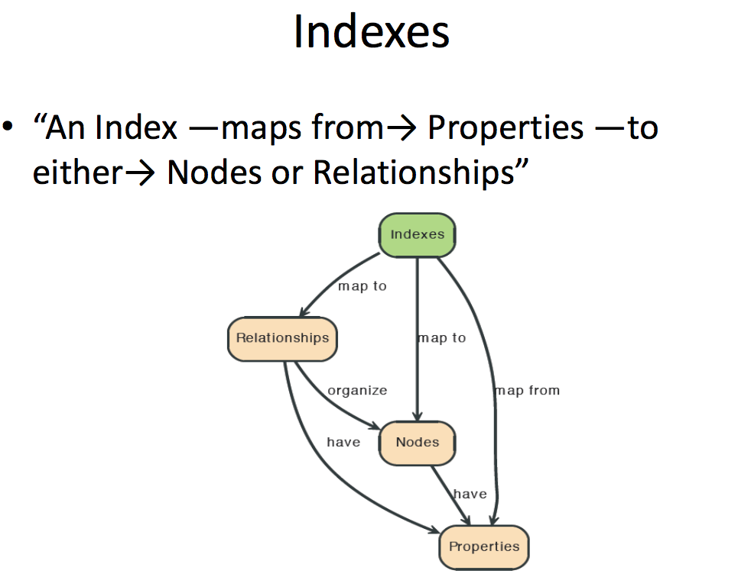

Slide 33
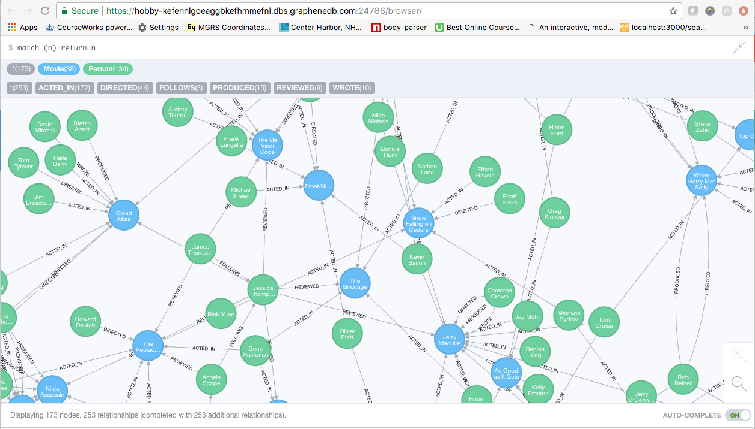
A Graph Database (Sample)

Slide 34
Neo4J Graph Query
Who acted in which movies?

Slide 35
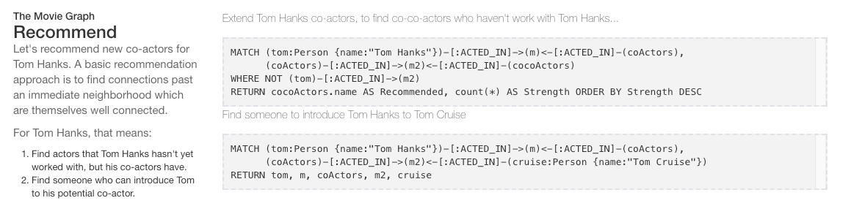
Big Deal. That is just a JOIN.
Yup. But that is simple.
Try writing the queries below in SQL.

Slide 36
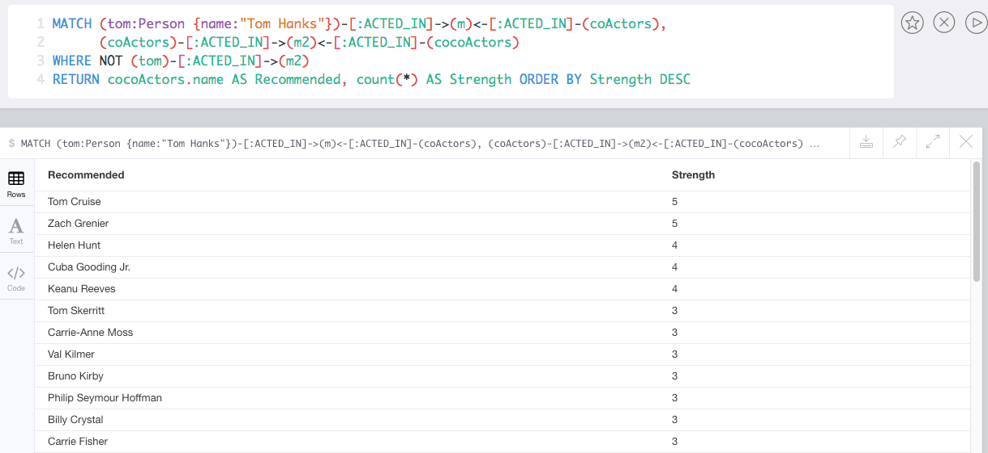
Recommend

Slide 37
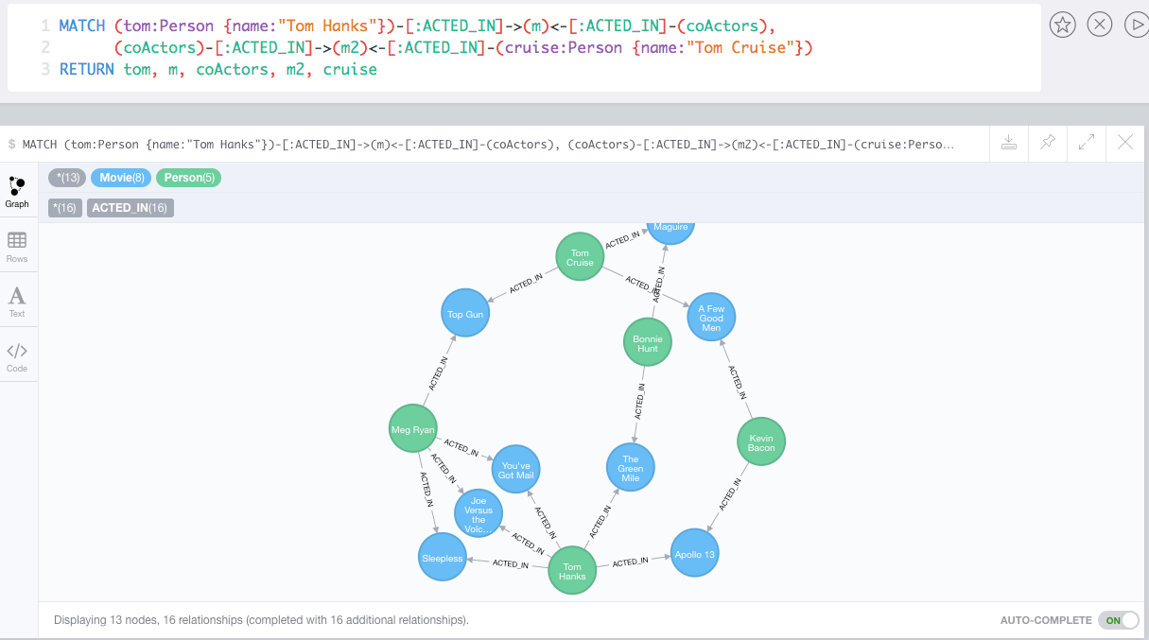
Which actors have worked with both Tom Hanks and
Tom Cruise?

Slide 38
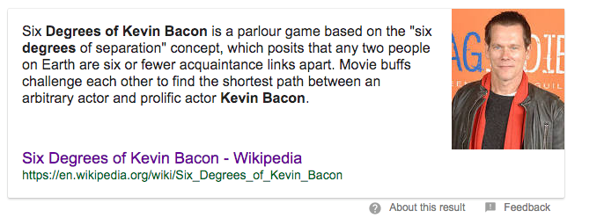
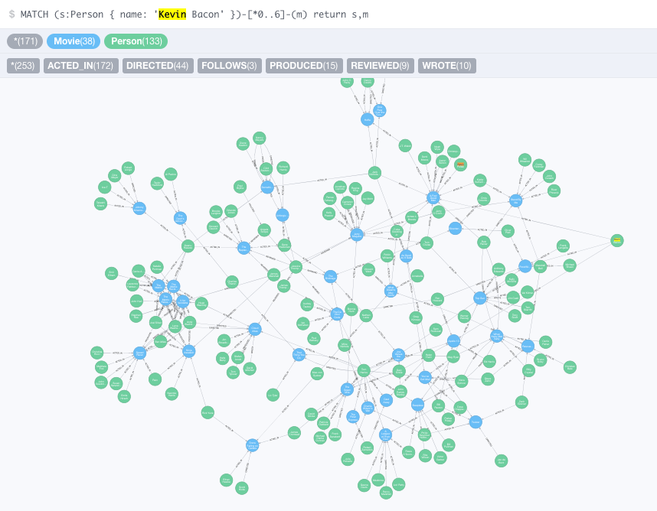

Notes:
Notion of querying paths….

Slide 39
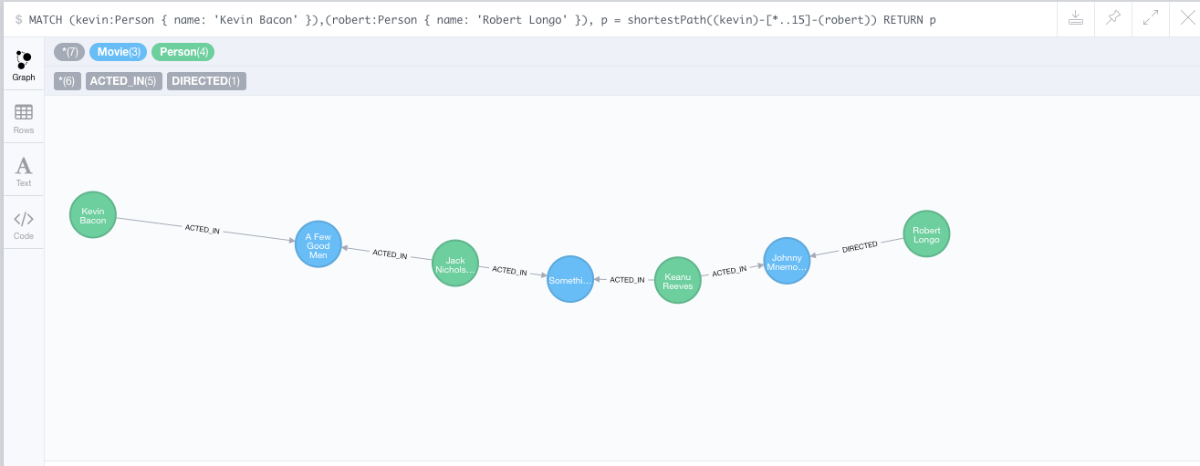
How do you get from Kevin Bacon to
Robert Longo?

Slide 40
Facebook Graph API
40 | Introduction to Databases (S20): Lecture 12 -- NoSQL

Slide 41
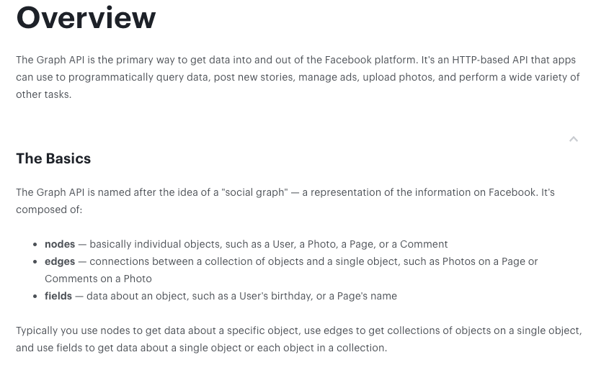
Facebook Graph API
https://developers.facebook.com/docs/graph-api/overview

Slide 42
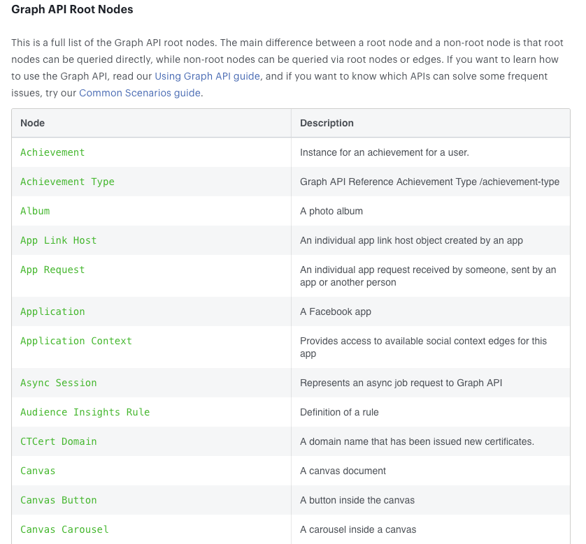
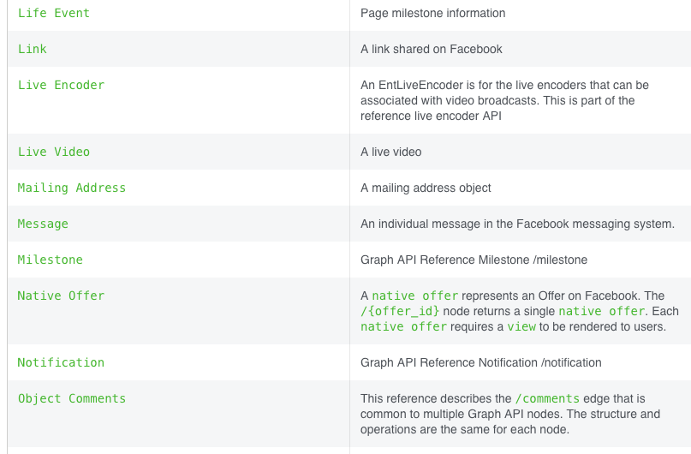
Facebook Graph API
Full list at:
https://developers.facebook.com/docs/graph-api/reference
… … …

Slide 43
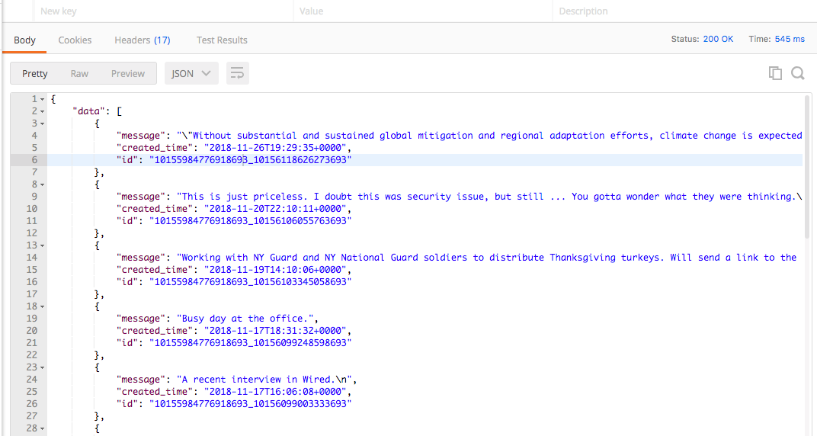
Facebook Graph API – Examples
https://graph.facebook.com/v3.2/me/posts?access_token=xxxxxxx

Slide 44
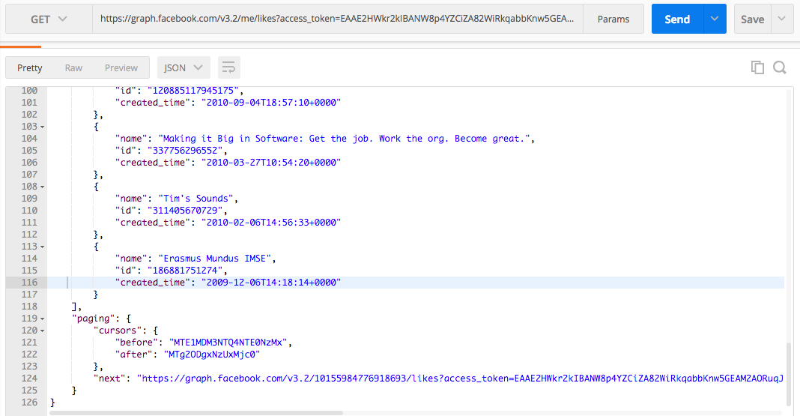
Facebook Graph API – Examples
https://graph.facebook.com/v3.2/me/likes?access_token=xxxxxxx
Notice use of paging links.

Slide 45
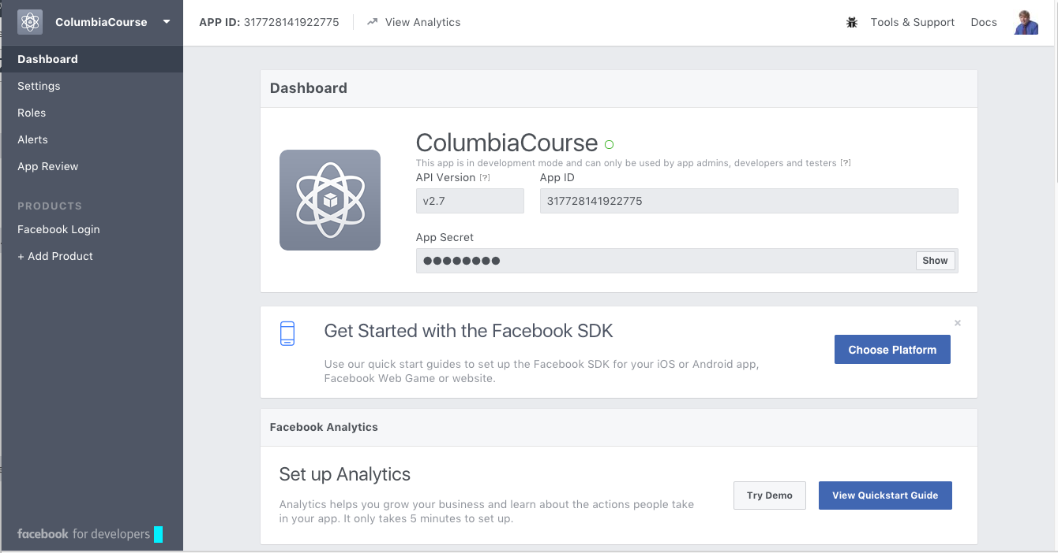
Facebook Applications
Facebook Application
Define an application at developers.facebook.com/apps/
Users log into your application via Facebook.
This grants your application permission to access the user’s Facebook content.
User must approve access on login and Facebook must “approve” the application for non-profile information.
Once logged onto your application via Facebook, you can
Get basic information about people.
Enable people to share, etc. information from your application to Facebook.
Perform analytics on users and their networks, subject to granted permissions.

Slide 46
Graph Database Summary
46 | Introduction to Databases (S20): Lecture 12 -- NoSQL

Slide 47
Graph Databases
Popularity and usage has exploded in the past few years.
Facebook Graph API (https://developers.facebook.com/docs/graph-api/)
LinkedIn (https://developer.linkedin.com/docs/rest-api)
Instagram (https://developers.facebook.com/docs/instagram-api)
Google Knowledge Graph (https://developers.google.com/knowledge-graph/)
Two major motivations:
Many common types of data are inherently graph oriented, and representing in RDB or some other mechanism results in icky code.
Performs of common graph operations is extremely slow in RDB.
Notes:
Impedence mismatch: Solution is not the easiest way to solve the problem

Slide 48
Redis
48 | Introduction to Databases (S20): Lecture 12 -- No SQL

Slide 49



Redis
Redis Key-Value Database:
Practical Introduction
SoftUni Team
Technical Trainers
Software University
http://softuni.bg

Slide 50

Redis
Ultra-Fast Data Structure Server

Slide 51

What is Redis?
Redis is:
Ultra-fast in-memory key-value data store
Powerful data structure server
Open-source software: http://redis.io
Redis stores data structures:
Strings, lists, hashes, sets, sorted sets
Publish / subscribe messaging

Slide 52

Redis: Features
Redis is really fast
Non-blocking I/O, single threaded
100,000+ read / writes per second
Redis is not a database
It complements your existing data storage layer
E.g. StackOverflow uses Redis for data caching
For small labs Redis may replace entirely the database
Trade performance for durability → data is persisted immediately

Slide 53
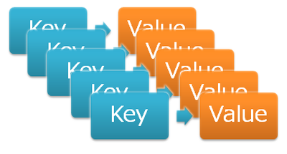
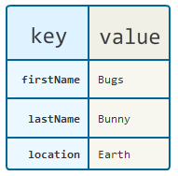
Redis: Data Model
Redis keeps key-value pairs
Every item is stored as key + value
Keys are unique identifiers
Values can be different data structures:
Strings (numbers are stored as strings)
Lists (of strings)
Hash tables: string → string
Sets / sorted sets (of strings)

Slide 54
Redis: Commands
Redis works as interpreter of commands:
SET name "Nakov"
OK
GET name
"Nakov"
DEL name
(integer) 1
GET name
(nil)
Play with the command-line client redis-cli
Or play with Redis online at http://try.redis.io

Slide 55
String Commands
SET [key] [value]
Assigns a string value in a key
GET [key] / MGET [keys]
Returns the value by key / keys
INCR [key] / DECR [key]
Increments / decrements a key
STRLEN [key]
Returns the length of a string
SET name "hi"
OK
GET name
"hi"
SET name abc
OK
GET "name"
"abc"
GET Name
(nil)
SET a 1234
OK
INCR a
(integer) 1235
GET a
"12345"
MGET a name
1) "1235"
2) "asdda"
STRLEN a
(integer) 4

Slide 56
Working with Keys
EXISTS [key]
Checks whether a key exists
TYPE [key]
Returns the type of a key
DEL [key]
Deletes a key
EXPIRE [key] [t]
Deletes a key after t seconds
SET count 5
OK
TYPE count
string
EXISTS count
(integer) 1
DEL count
(integer) 1
EXISTS count
(integer) 0
SET a 1234
OK
GET a
"1234"
EXPIRE a 5
(integer) 1
EXISTS a
(integer) 1
EXISTS a
(integer) 0

Slide 57
Working with Hashes (Hash Tables)
HSET [key] [field] [value]
Assigns a value for given field
HKEYS [key]
Returns the fields (keys) is in a hash
HGET [key] [field]
Returns a value by fields from a hash
HDEL [key] [field]
Deletes a fields from a hash
HSET user name "peter"
(integer) 1
HSET user age 23
(integer) 1
HKEYS user
1) "name"
2) "age"
HGET user age
"23"
HDEL user age
(integer) 1

Slide 58
Working with Lists
RPUSH / LPUSH [list] [value]
Appends / prepend an value to a list
LINDEX [list] [index]
Returns a value given index in a list
LLEN [list]
Returns the length of a list
LRANGE [list] [start] [count]
Returns a sub-list (range of values)
RPUSH names "peter"
(integer) 1
LPUSH names Nakov
(integer) 1
LINDEX names 0
"Nakov"
LLEN names
(integer) 2
LRANGE names 0 100
1) "Nakov"
2) "peter"

Slide 59
Working with Sets
SADD [set] [value]
Appends a value to a set
SMEMBERS [set]
Returns the values from a set
SREM [set] [value]
Deletes a value form a set
SCARD [set]
Returns the stack size (items count)
SADD users "peter"
(integer) 1
SADD users "peter"
(integer) 0
SADD users maria
(integer) 1
SMEMBERS users
1) "peter"
2) "maria"
SREM users maria
(integer) 1

Slide 60
Working with Sorted Sets
ZADD myzset 1 "one"
(integer) 1
ZADD myzset 1 "uno"
(integer) 1
ZADD myzset 2 "two" 3 "three"
(integer) 2
ZRANGE myzset 0 -1 WITHSCORES
1) "one"
2) "1"
…
Learn more at http://redis.io/commands#sorted_set

Slide 61
Publish / Subscribe Commands
First user subscribes to certain channel "news"
Another user sends messages to the same channel "news"
Learn more at http://redis.io/commands#pubsub
SUBSCRIBE news
1) "subscribe"
2) "news"
3) (integer) 1
PUBLISH news "hello"
(integer) 1

Slide 62
Using Redis as a Database
Special naming can help using Redis as database
Add a user "peter".
SADD users:names peter
HSET users:peter name "Peter Petrov"
HSET users:peter email "pp@gmail.com"
SADD users:names maria
HSET users:maria name "Maria Ivanova"
HSET users:maria email "maria@yahoo.com"
SMEMBERS users:names
HGETALL users:peter
Use "users:peter" as key to hold user data
Add a user "maria".
List all users
List all properties for user "peter"

Slide 63


Summary
Redis is ultra-fast in-memory data store
Not a database, used along with databases
Supports strings, numbers, lists, hashes, sets, sorted sets, publish / subscribe messaging
Used for caching / simple apps
Databases
Notes:
Redis-Commander – Redis version of MySQL Workbench

Slide 64
DynamoDB
64 | Introduction to Databases (S20): Lecture 12 -- No SQL

Slide 65
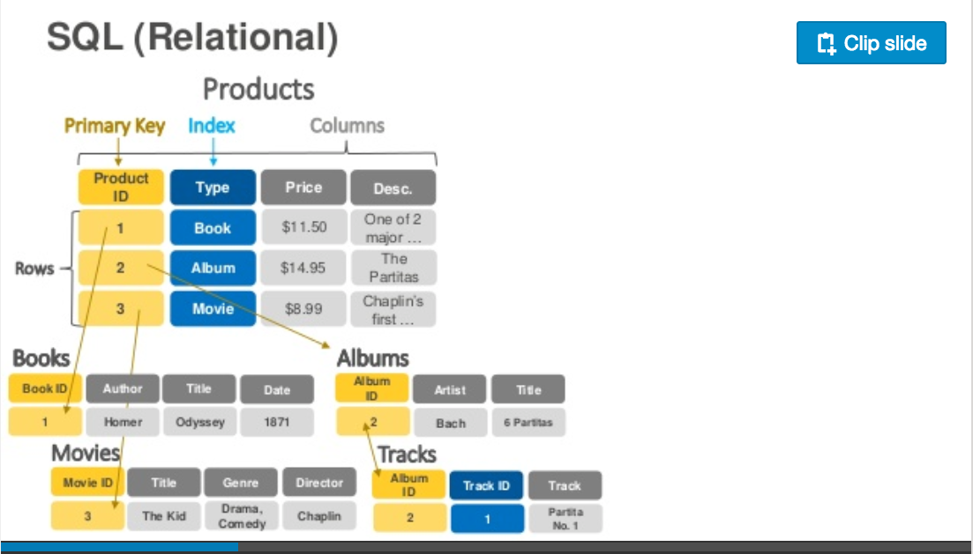
DynamoDB Data Model
https://www.slideshare.net/AmazonWebServices/introduction-to-amazon-dynamodb-73191648

Slide 66
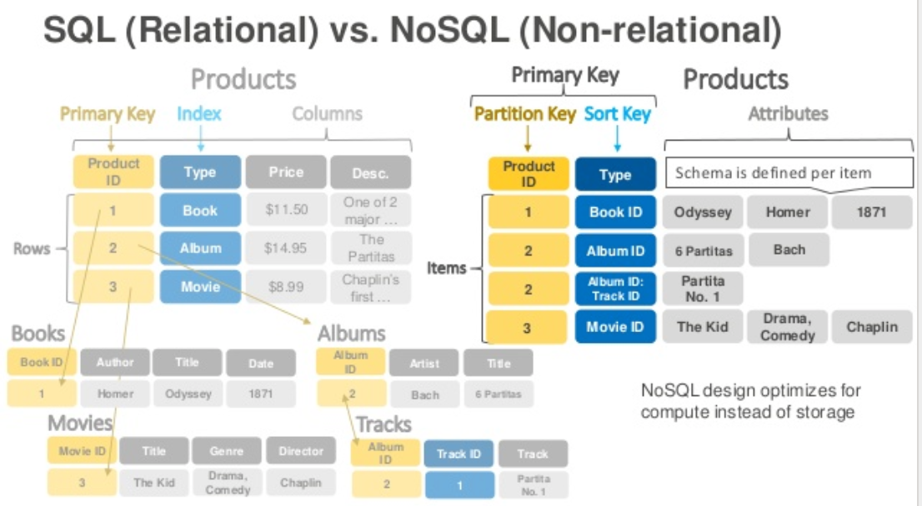
DynamoDB Data Model

Slide 67
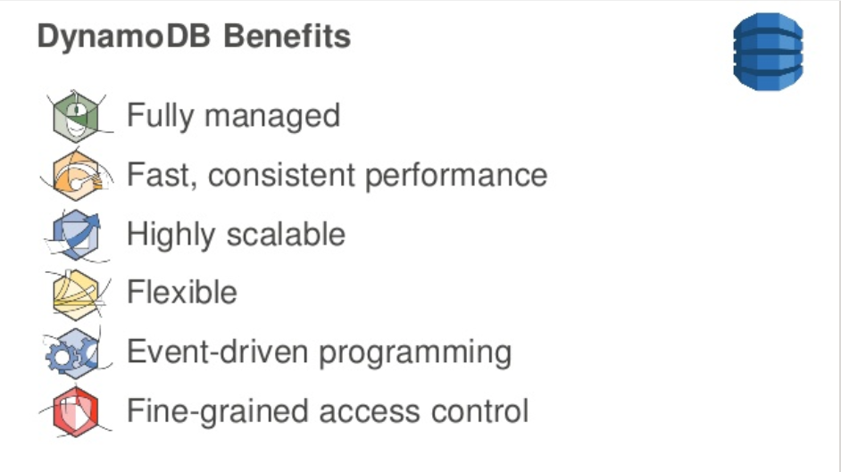
DynamoDB

Slide 68
DynamoDB Hashing

Slide 69
Approaches to Scalability

Slide 70
Share Nothing Architecture

Slide 71
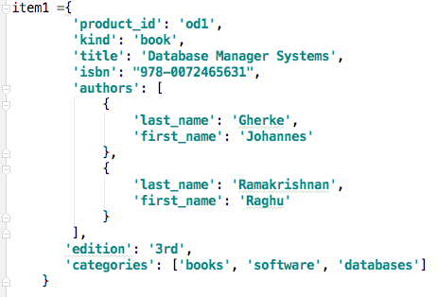
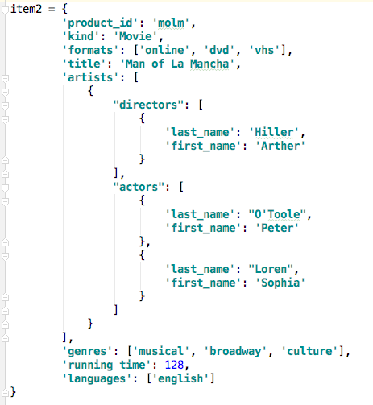
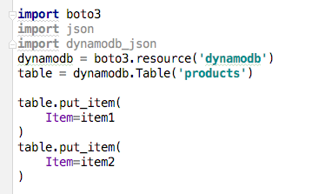
Sample Code

Slide 72
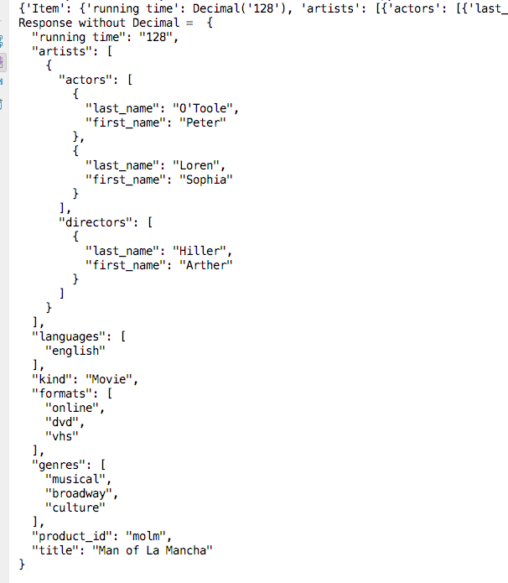
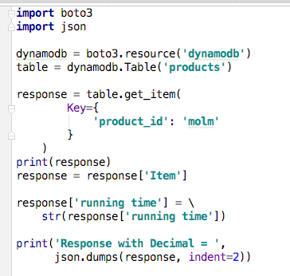
Sample Code

Slide 73
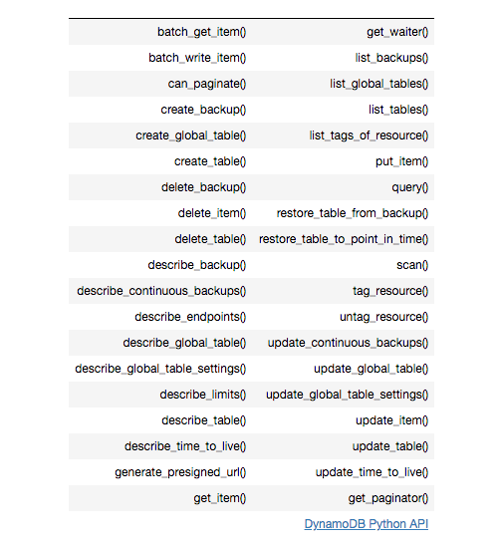
DynamoDB Summary
Achieves much greater scalability and performance than RDBMs
Does not support some RDBMs capabilities:
Referential integrity.
JOIN
Queries limited to key fields.
Non-key field queries are always scans.
Data model better fit for semi-structured data models and good fit for JSON
Maps
Lists

